Slide 1

Cloud-Based Integrated Development Environment
Sahil Suhas Sadekar
Guide- MRS. A. A. JAMGAONKAR
Seminar
PES Modern College of Engineering Department of Computer Engineering Savitribai Phule Pune University
October 24, 2024
Short Title

Slide 2


Outline
Introduction
Literature Survey
Literature Survey
Literature Survey
Objectives and Scope
6
7
8
9
Problem Statement Architectural Diagram 1 Algorithm Explanation Architectural Diagram 2
Current Working Models for Cloud IDEs Resource Allocation Techniques Limitations
Current Working Models for Cloud IDEs (Continued) Eclipse Che
CodeSandbox
Algorithmic Approach
Algorithmic Approach (1/2)
14 Algorithmic Approac
(2/2)h
Dept of Comp Engg
Short Title

Slide 3
Introduction
As software development evolves, the demand for flexible, scalable, and high-performing development environments is greater than ever.
Cloud-Based Integrated Development Environments (IDEs) provide developers with remote access to powerful tools, removing the limitations of local hardware and enhancing collaboration. However, managing cloud resources efficiently remains a challenge. This is where Machine Learning (ML) comes in. By integrating advanced ML algorithms, especially reinforcement learning, cloud IDEs can intelligently allocate resources based on real-time usage patterns. This ensures that developers have the resources they need, exactly when they need them, optimizing performance while minimizing costs.
Short Title

Slide 4
Literature Survey (1/3)
Early Research (2012): Focused on resource constraints and collaboration in distributed teams (Buse and Zimmermann).
Architecture Design (2018): Explored cloud resource allocation and IDEs using virtualized environments (IEEE Access).
Scalability (2019): Shift towards containerization (Docker) for productivity and scalability (IEEE Transactions on Cloud Computing).
Advanced Container Management (2020): Kubernetes automates container management, enabling auto-scaling and improved performance (IEEE Cloud Computing).
Short Title

Slide 5
Literature Survey (2/3)
Early Research (2012): Focused on resource constraints and collaboration in distributed teams (Buse and Zimmermann).
Architecture Design (2018): Explored cloud resource allocation and IDEs using virtualized environments (IEEE Access).
Reinforcement Learning (RL) for Smart Resource Allocation and Auto-scaling:
RL-based Auto-Scaling (2019): RL methods, such as Q-learning and policy-gradient methods, enable dynamic, real-time resource management, outperforming traditional approaches (IEEE Access).
Short Title

Slide 6
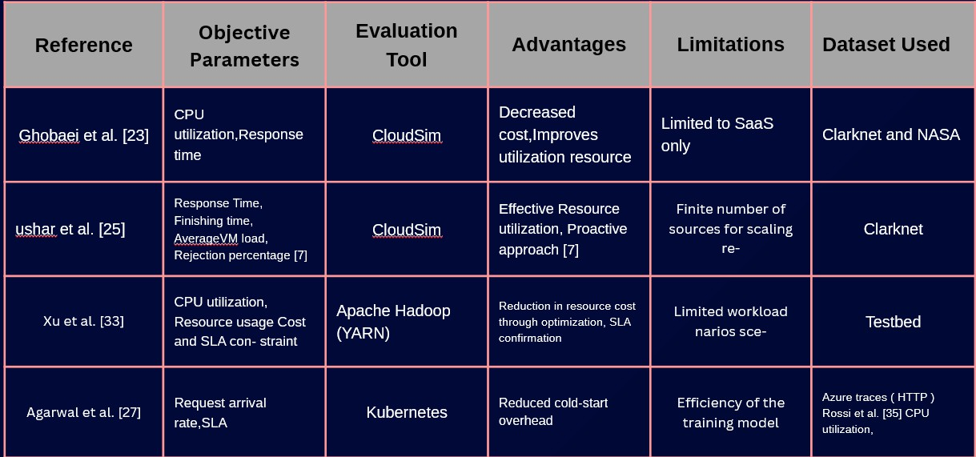
Literature Survey (3/3)
Figure: Literature Overview
Short Title

Slide 7
Objectives and Scope
To analyze the current landscape of cloud-based IDEs and their fea- tures.
To identify the challenges faced by developers in adopting cloud-based IDEs
To propose solutions that improve the performance, security, and us- ability of cloud-based IDEs.
Optimize Resource Allocation Using Machine Learning: Implement ML algorithms (such as reinforcement learning) to dynamically allocate cloud resources based on real-time user demand, ensuring efficient use of computing power and reducing idle resources.
Short Title

Slide 8
Problem Statement
Despite the advantages of cloud-based IDEs, many developers face challenges related to performance, security, and integration with exist- ing workflows. Issues such as latency, data privacy concerns, and lim- ited functionality compared to traditional IDEs can hinder the adoption of cloud-based solutions. Identifying and addressing these challenges is critical for enhancing the effectiveness and reliability of cloud-based IDEs.
Short Title

Slide 9
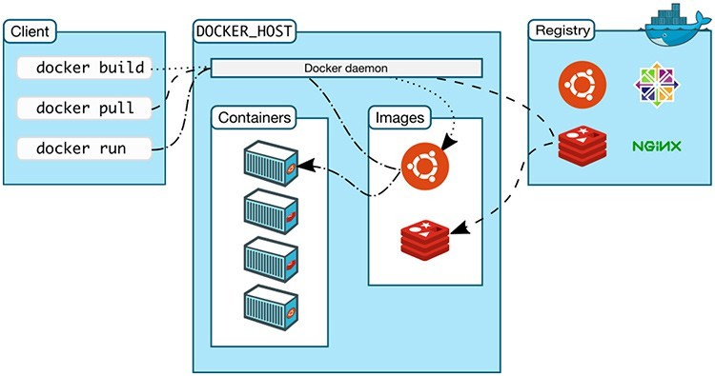
Architectural Diagram (1):
Figure: Figure 1: System Architectural Diagram
Short Title

Slide 10
Algorithm Explanation
Containerization for Isolation:
Docker containers ensure each user’s development environment is isolated, avoiding conflicts between dependencies or resources. Users have their own sandboxed workspace, enhancing security and preventing interference between environments.
Decentralized Container Management:
Each user’s development environment is encapsulated in its dedicated container, creating a scalable and decentralized approach. Containers can be distributed across multiple nodes, improving resource distribution and fault tolerance.
Short Title

Slide 11
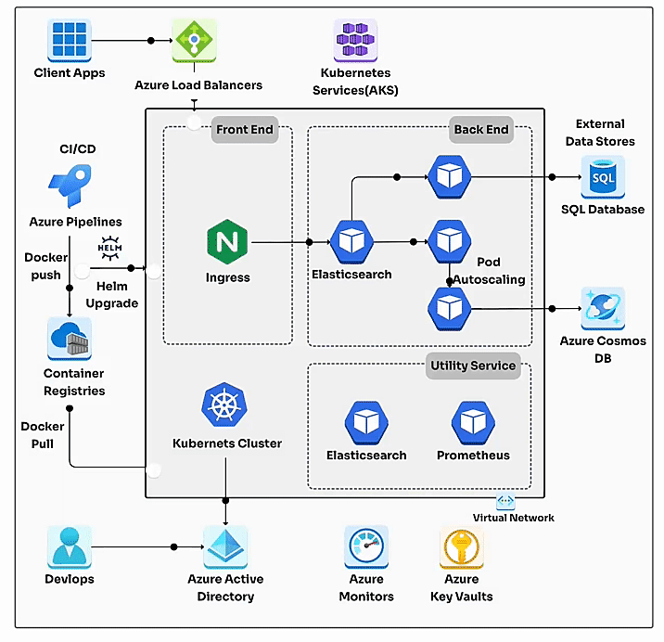
Architectural Diagram (2):
Short Title

Slide 12
Algorithm Explanation
Containerization for Isolation:
Docker containers ensure each user’s development environment is isolated, avoiding conflicts between dependencies or resources. Users have their own sandboxed workspace, enhancing security and preventing interference between environments.
Decentralized Container Management:
Each user’s development environment is encapsulated in its dedicated container, creating a scalable and decentralized approach. Containers can be distributed across multiple nodes, improving resource distribution and fault tolerance.
Kubernetes:
Orchestrates containerized workloads, enabling scaling and management of IDE instances.
Docker:
Provides isolated, consistent development environments via containers.
Ingress Controller:
Routes traffic to appropriate services, ensuring secure external access.
Azure Cloud:
Powers compute, storage, and networking with integrated services like Azure Kubernetes Service (AKS).
Persistent Storage:
Stores user data and project files using cloud-backed volumes.
Short Title

Slide 13
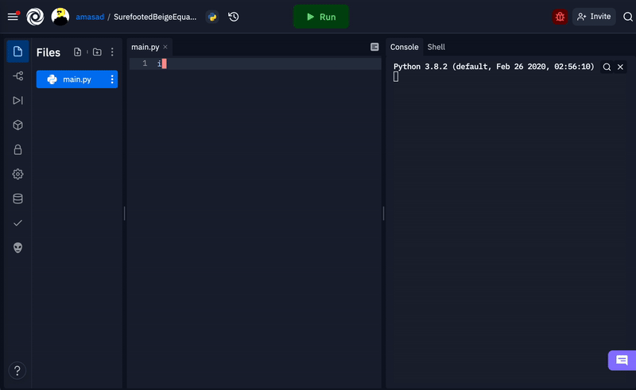
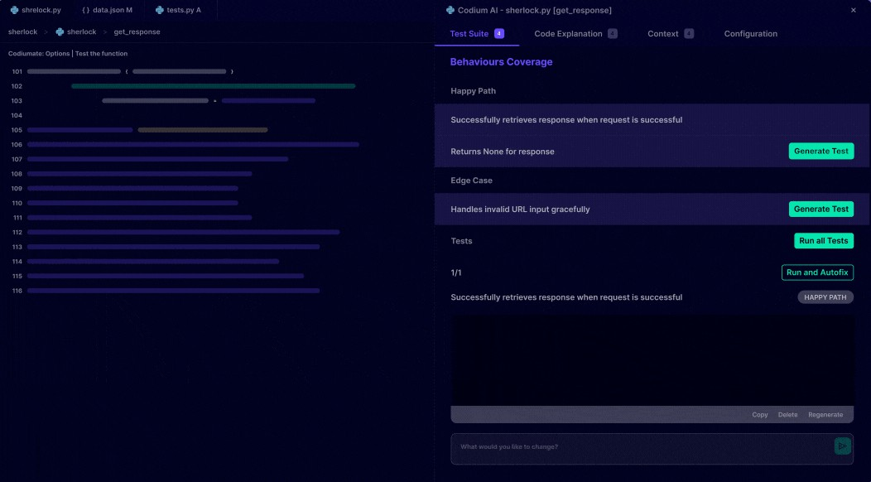
Popular Cloud IDEs, Resource Allocation Limitations (1):
Cloud IDEs employ various resource allocation techniques to balance performance and cost.
Static Allocation: Fixed resources, irrespective of demand.
Dynamic Allocation: Adjusts resources based on needs.
Auto-scaling: Automatically scales resources with load.
Each method has trade-offs:
Cost: Static allocation may lead to waste; auto-scaling can be costly.
Performance: Dynamic allocation boosts performance but adds complexity.
Figure: Cloud IDEs: Replit and Codium
Short Title

Slide 14
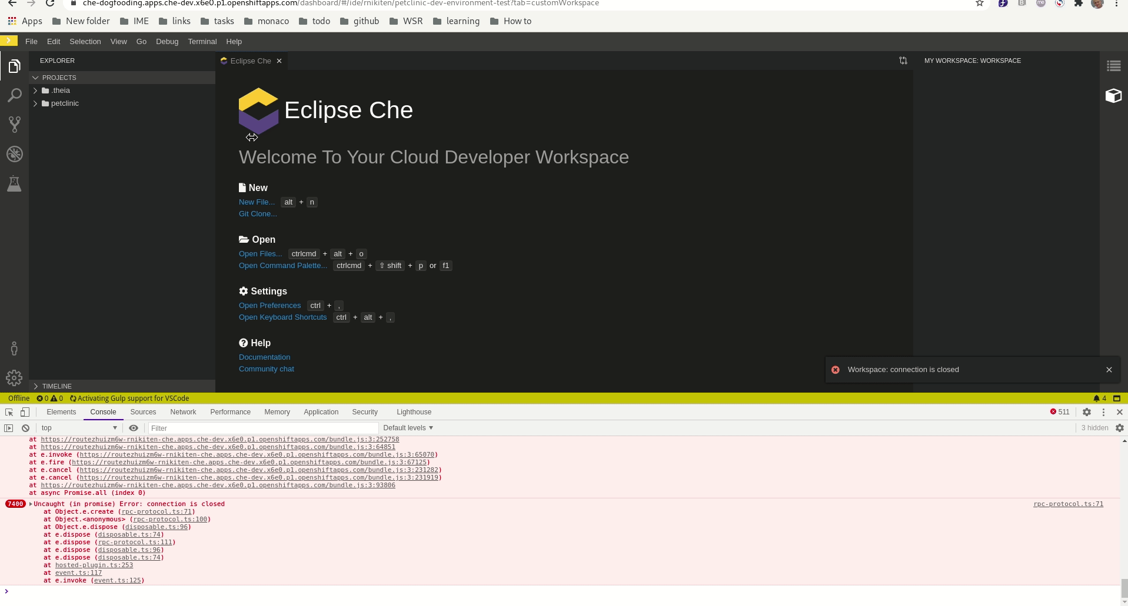
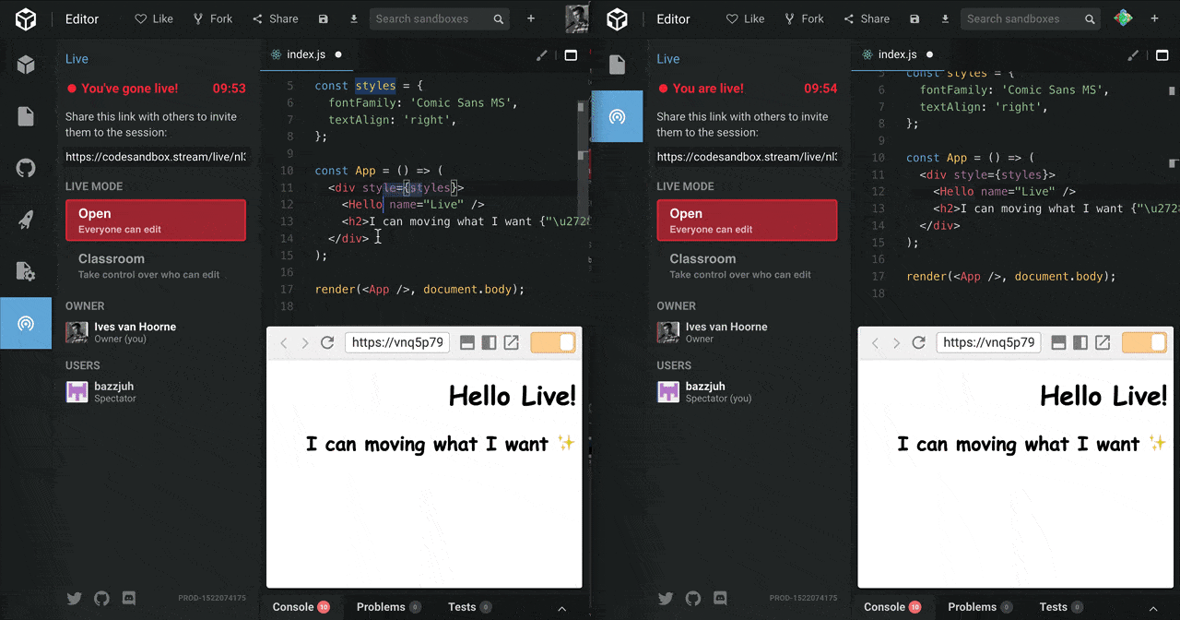
Popular Cloud IDEs, Resource Allocation Limitations (2):
Other popular cloud IDEs include solutions tailored for enterprise and rapid prototyping needs.
Description: A Kubernetes-native cloud Description: A web-based IDE optimized
IDE designed for enterprise development. for quick prototyping and collaboration.
*Eclipse Che
*CodeSandbox
Short Title

Slide 15
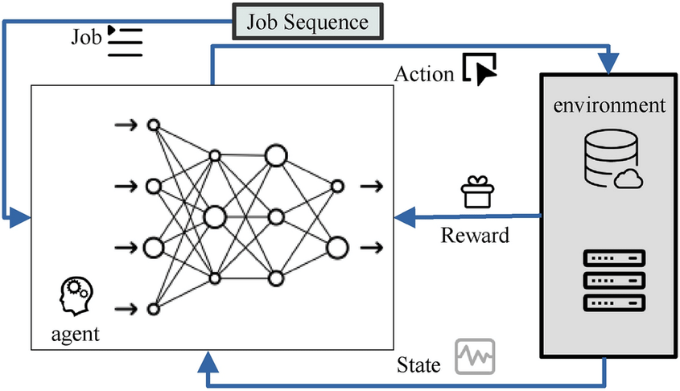
Algorithmic Approach (1/2)
Figure: Figure: Job Sequencing Algorithm
Short Title

Slide 16
Algorithmic Approach (1/2) (explanation)
Objective: Minimize cloud costs while meeting job deadlines.
Deep Reinforcement Learning (DRL): Learns optimal scheduling policies by balancing cost and performance.
Action: Allocate cloud resources (VMs/containers) based on current job and workload demand.
State: Includes job queue, resource availability, and cloud pricing.
Reward Function: Penalizes high costs and missed deadlines, rewards efficient resource use.
Cost Models: Considers on-demand, reserved, and spot instances pricing.
Dynamic Scaling: Adapts resource allocation in real-time as job workloads change.
Key Benefit: Reduces cloud expenses while maintaining job performance.
Short Title

Slide 17
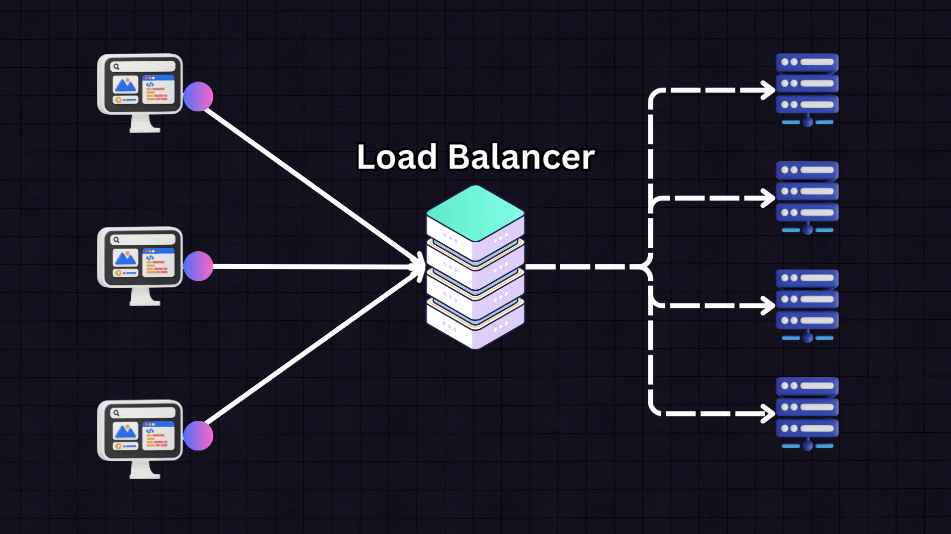
Algorithmic Approach (2/2)
Figure: Figure: Job Sequencing Algorithm
Short Title

Slide 18
Algorithmic Approach (2/2) (explanation)
Objective: Minimize cloud costs while meeting job deadlines.
Deep Reinforcement Learning (DRL): Learns optimal scheduling policies by balancing cost and performance.
Action: Allocate cloud resources (VMs/containers) based on current job and workload demand.
State: Includes job queue, resource availability, and cloud pricing.
Reward Function: Penalizes high costs and missed deadlines, rewards efficient resource use.
Cost Models: Considers on-demand, reserved, and spot instances pricing.
Dynamic Scaling: Adapts resource allocation in real-time as job workloads change.
Key Benefit: Reduces cloud expenses while maintaining job performance.
Short Title

Slide 19
Input / Dataset
The dataset is downloaded from: http://kdd.ics.uci.edu/databases/shuttle/shuttle.data.html.
The data is in a space-delimited ASCII format. Where:
For example, 2,0,0,0,0,0,1 where:
2 → Class number (indicating shuttle status), 0,0,0,0,0 → Feature values representing sensor data,
1 → Classification label (e.g., stable or unstable shuttle status).
This dataset is useful for real-time system monitoring or predictive maintenance tasks.
Short Title

Slide 20
Conclusion
Transformative Impact: Cloud-based IDEs have changed software de- velopment practices by enabling greater collaboration, accessibility, and scalability.
Real-time Collaboration: Teams can work together seamlessly from different locations, enhancing innovation and efficiency. : Security concerns, dependence on internet connectivity, and limitations with resource-intensive applications are potential drawbacks of cloud IDEs.
Advantages: Benefits such as reduced setup time, cost-effectiveness, and access to powerful cloud resources often outweigh the challenges.
Using website ontology with the technique can provide more precise recommendations.
Feature Analysis: The report includes an analysis of various cloud IDEs, discussing their strengths and weaknesses.
Short Title

Slide 21
References I
B. Smith, “The Future of Development: Cloud-Based Integrated Development Environments,” Journal of Software Engineering, vol. 45, no. 3, pp. 200-215, 2023.
R. Johnson and M. Patel, “A Comprehensive Survey on Cloud IDEs: Trends and Challenges,” Proceedings of the International Conference on Software Development, London, UK, July 2023, pp. 45-52.
A. Lee, “Cloud Computing and the Development Lifecycle: An
In-Depth Analysis,” IEEE Transactions on Cloud Computing, vol. 10, no. 1, pp. 50-62, 2024.
P. Gupta and L. K. Zhang, “Collaborative Software Development in the Cloud: A Study of Cloud IDEs,” International Journal of Computer Applications, vol. 175, no. 8, pp. 18-25, 2024.
Short Title

Slide 22

Short Title

